Slide 1
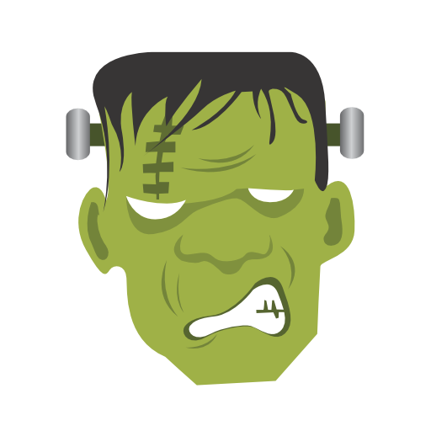
Frankenstein in Popular Culture
By Shela Nguyen

Slide 2
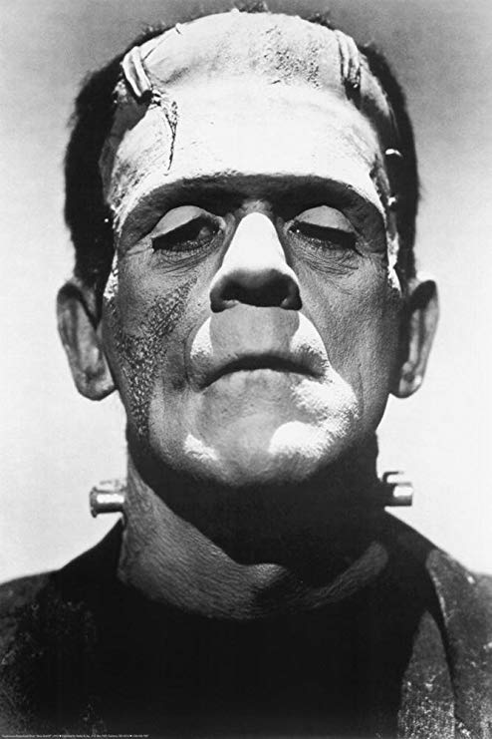
Film Adaptations
The 1931 film adaptation of “Frankenstein” is the a notable adaptation of the book, featuring Boris Karloff as Frankenstein’s Monster
The monster is generally one of the most recognizable icons in the horror genre
“Mary Shelley’s Frankenstein (1994)” is considered the most faithful adaptation to the novel, though some parts were considerably distinct from each other
Boris Karloff as Frankenstein’s Monster, depicted in the 1931 film “Frankenstein.”

Slide 3
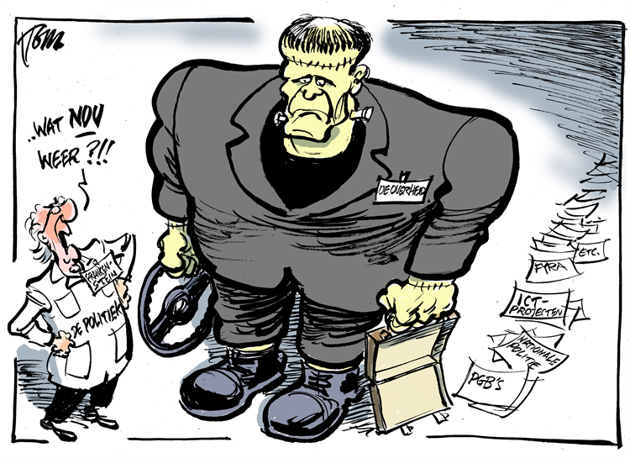
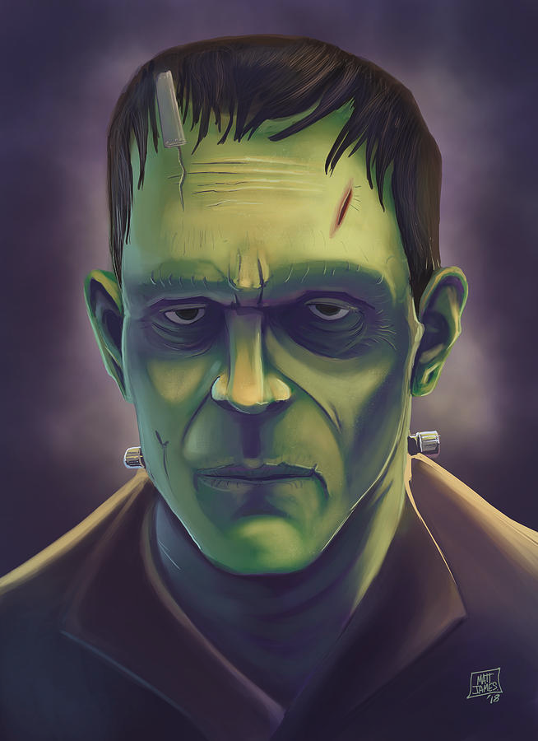
Artwork Depictions
The most commonly given appearance of Frankenstein’s monster is his signature unusual green skin
Also shown to have huge scars and stitches on his face
The idea of bolts in his neck was never in the novel but was popularized through film adaptations
Frankenstein’s monster was even featured in some political cartoons

Slide 4
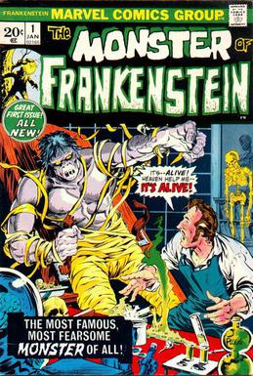
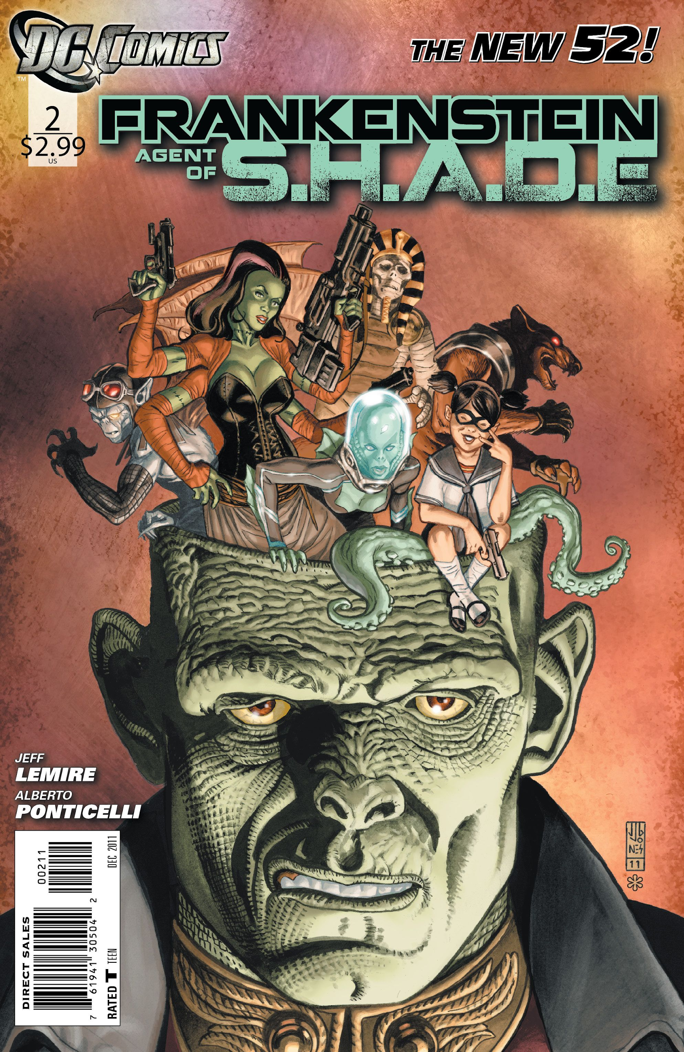
Graphic Novels
“Frankenstein” also had its fair share of graphic novel adaptations from both DC and Marvel Comics
The characters were based on Mary Shelley’s “Frankenstein” but were often involved within the comic universe
Often shared abilities such as superhuman strength, stamina, and immortality

Slide 5
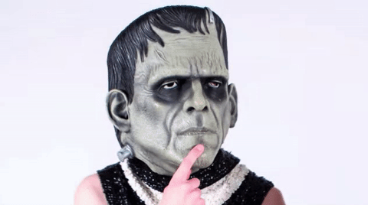
Misconceptions of “Frankenstein”
People think of the monster when they think of “Frankenstein,” though Victor Frankenstein is the name of the scientist
The monster is thought to be cretinous and dopey with zombie-like movements based on film adaptations, whereas in Mary Shelley’s novel, he has a strong intellect and is fully capable of human speech
HIs appearance in film adaptations is completely inaccurate, as the monster’s skin is described as yellow instead of green. He was also never given bolts in his neck and his appearance was horrifying to look at
Victor Frankenstein is not crazy but depicted as a typical “mad scientist.” He is driven by the death of his mother to create the monster
Hmm...

Slide 6
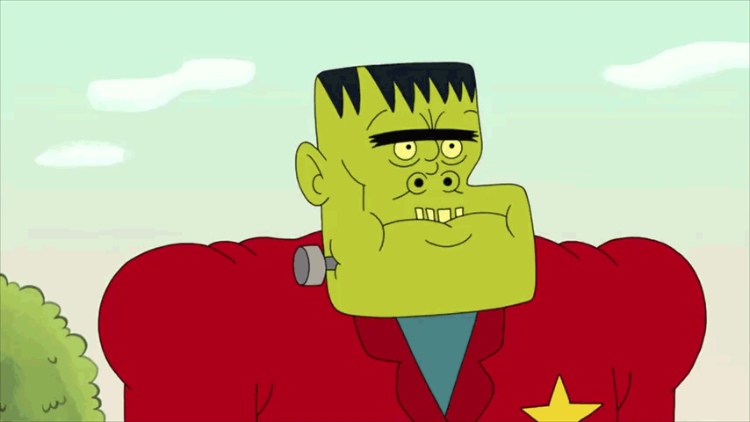
Significance of Mary Shelley’s “Frankenstein”
The depictions, often times, are very distinct from the original source material in terms of storylines and characters
In popular culture, the monster is often thought of when referring to “Frankenstein”
The Hollywood film adaptations led people to believe the monster to be brain-dead and zombie-like
The monster is one of the most iconic characters in the horror genre

Slide 7
FIN.

